Slide 1

How to Use Technology
June 9, 2026
Christopher Hershey, CFP®, CRPC®
Michelle Sweigart, FPQPTM

Slide 2

Seminar Overview
Zoom Meeting Basics (including a demonstration)
  Learn to join Zoom meetings, navigate controls, and adjust camera and audio for comfort.
DocuSign Electronic Signing (including a demonstration)
  Understand how DocuSign securely enables electronic document signing to save time and resources.
Effective Email Tips
  Discover how to protect yourself from suspicious or scam messages.

Slide 3
Why This Matters
Staying Connected
  Technology enables communication with family, friends, and professionals regardless of distance through video calls and emails.
Saving Time and Convenience
  Many tasks like signing documents and attending appointments can now be done from anywhere, creating convenience and saving time.
Supporting Independence
  Technology tools like calendars and email reminders help manage schedules and enhance organization and independence.
Building Confidence
  Learning basic technology skills empowers users to feel comfortable and confident using practical digital tools.

Slide 4

Introduction to Zoom
Versatile Video Platform
  Zoom enables face-to-face meetings over the internet on multiple devices like computers, tablets, and smartphones.
User-Friendly Access
Enhanced Communication Features
  Zoom includes chat, reactions, and screen sharing to improve interaction during meetings.
Comfortable Participation
  Familiarizing with Zoom’s basic layout helps reduce anxiety and ensures comfortable meeting participation.

Slide 5
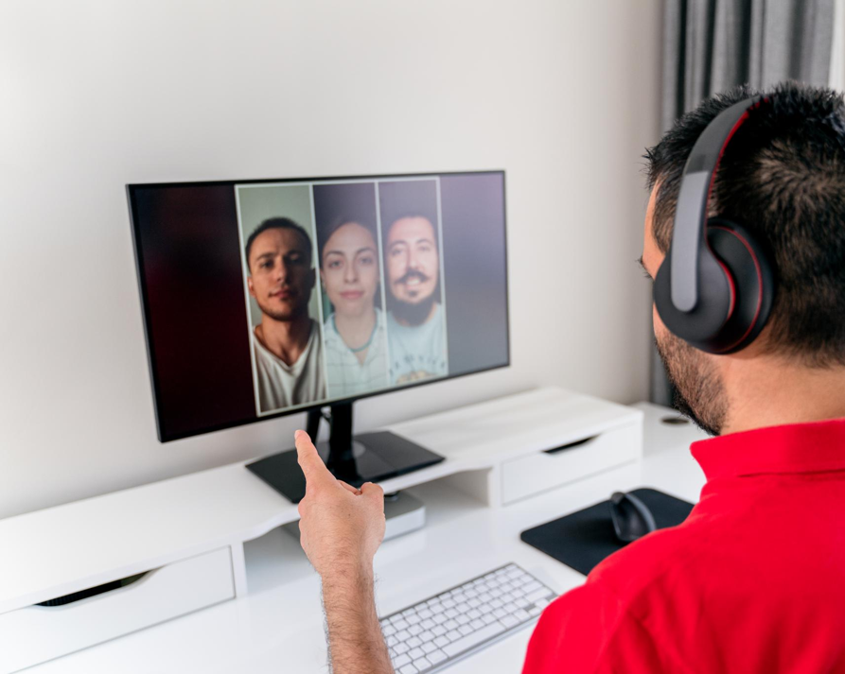
Zoom Best Practices
Join Early and Prepare
  Arriving early allows time to check audio and video settings before the meeting starts.
Mute When Not Speaking
  Muting microphones reduces background noise and prevents distractions during meetings.
Engage Respectfully
  Use chat and reactions appropriately to show respect and stay engaged with the speaker.
Quiet Environment
  Sitting in a quiet space and informing others helps minimize interruptions.

Slide 6

Introduction to DocuSign
Electronic Signature Convenience
  DocuSign enables signing documents online without printing or mailing, saving time and effort.
Security and Reliability
  DocuSign provides a safe, secure platform widely trusted by healthcare, banking, real estate, and other sectors.
User-Friendly Interface
  DocuSign offers clear instructions making the signing process easy for all users.
Legal Validity and Acceptance
  Electronic signatures through DocuSign are legally valid and widely accepted worldwide.

Slide 7

How DocuSign Works
Secure Document Access
  Users receive an email with a secure link to access and review documents ready for signing.
Guided Signing Process
  DocuSign guides users step-by-step, highlighting where to read, initial, or sign in the document.
Multiple Signature Options
  Users can choose typed, drawn, or saved signature styles to sign documents electronically.
Completion Confirmation
  Both sender and signer receive confirmation once the document has been signed and submitted.

Slide 8

Email Safety Tips
Avoid Suspicious Links
  Do not click on links or download attachments from untrusted email sources to protect your devices.
Verify Sender’s Identity
  Check the sender's email address carefully or contact the organization directly to confirm authenticity.
Use Strong Passwords
  Use strong, unique passwords for your email accounts to add an extra layer of protection.
Leverage Spam Filters
  Enable spam filters that automatically move suspicious emails out of your inbox for safer email use.

Slide 9

Upcoming Seminars
Bring a Friend to Lunch (Ciro’s Italian Bistro)
Tuesday, June 16, 2026
12:00 PM
VA Benefits
Tuesday, July 7, 2026
11:00 AM
The Manor – If These Walls Could Talk
Thursday, July 9, 2026
11:00 AM

Slide 10
Thank You!
Rodgers-Associates.com
(717) 560-3800
2025 Lititz Pike
Lancaster, PA 17601

